Slide 1
Unit-5 Software Testing

Slide 2
Introduction to Software Testing
Software testing is a process used to identify the correctness, completeness and quality of developed software”.
Testing is the process of exercising and evaluating a system or system component by manual or automated means to verify that it satisfies specified requirements.
Testing is concerned with errors, faults, failures and incidents. A test is the act of exercising software with an objective of:
Finding failure Demonstrate correct execution
Software testing is a process used to identify the correctness, completeness, and quality of developed computer software. It includes a set of activities conducted with the intent of finding errors in software so that it could be corrected before the product is released to the end users.

Slide 3
Introduction to Software Testing
In simple words, software testing is an activity to check whether the actual results match the expected results and to ensure that the software system is defect free.
OR
It can also be stated as the process of validating and verifying that a software program or application or product: Meets the business and technical requirements that guided its design and development. Works as expected. Can be implemented with the desired characteristics.

Slide 4
Software Testing Life Cycle (STLC)
Once the project is confirmed to start, project development can be divided into following phases:
Software requirements phase
Software Design
Implementation
Testing
Maintenance
These phases form a model called as a waterfall model, a linear sequential model or software development life cycle, which suggests a systematic, sequential approach to software development.
Software Testing Life Cycle (STLC) model is basically developed to identify which testing activities needs to be carried and what’s the best time to perform them to accomplish those test activities. Even though testing differs between organizations, there is a testing life cycle

Slide 5
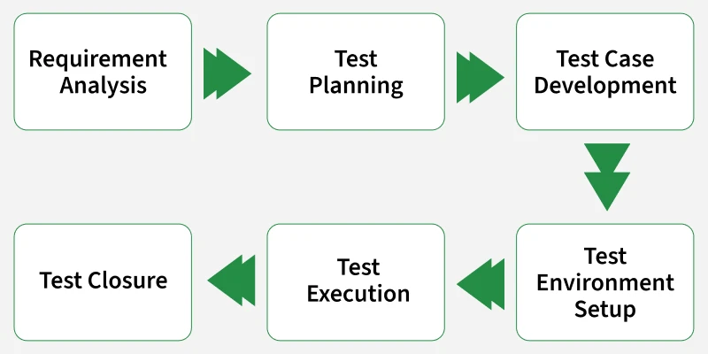
Software Testing Life Cycle (STLC)

Slide 6
Software Testing Life Cycle (STLC)
Requirement Analysis
Requirement Analysis is the first phase where the QA/testing team understands what needs to be tested. The activities that take place during the Requirement Analysis stage include:
Reviewing the software requirements document (SRD) and other related documents
Interviewing stakeholders to gather additional information
Identifying any ambiguities or inconsistencies in the requirements
Identifying any missing or incomplete requirements
Identifying any potential risks or issues that may impact the testing process

Slide 7
Software Testing Life Cycle (STLC)
2. Test Planning
Test Planning is the most crucial phase where the overall test strategy and plan are created. The major activities carried out during the Test Planning phase include:
Identifying the testing objectives and scope
Developing a test strategy: selecting the testing methods and techniques that will be used
Identifying the testing environment and resources needed
Identifying the test cases that will be executed and the test data that will be used
Estimating the time and cost required for testing
Identifying the test deliverables and milestones
Assigning roles and responsibilities to the testing team
Reviewing and approving the test plan

Slide 8
Software Testing Life Cycle (STLC)
3. Test Case Development
The Test Case Development phase testers design detailed test cases and prepare the necessary test data. The main activities performed during the Test Case Development phase include:
Identifying the test cases that will be developed
Writing test cases that are clear, concise and easy to understand
Creating test data and test scenarios that will be used in the test cases
Identifying the expected results for each test case
Reviewing and validating the test cases
Updating the requirement traceability matrix (RTM) to map requirements to test cases

Slide 9
Software Testing Life Cycle (STLC)
4. Test Environment Setup
Test Environment Setup defines the hardware, software and network conditions under which testing will be executed. The activities involved in the Test Environment Setup phase include:
Install and configure required software, tools and databases.
Set up servers, browsers, operating systems and devices.
Prepare access credentials and permissions.
Validate the environment before test execution

Slide 10
Software Testing Life Cycle (STLC)
5. Test Execution
In Test Execution phase prepared test cases are executed in the defined environment. The activities performed during the Test Execution phase include:
Run manual or automated test cases.
Re-test fixed defects (defect retesting).
Perform regression testing if required.
Collect and analyze test results.
Document and share test reports.

Slide 11
Software Testing Life Cycle (STLC)
6. Test Closure
Test Closure is the final phase where testing activities are completed and documented. The final activities carried out during the Test Closure phase include:
Prepare a Test Summary Report (test cases executed, pass/fail count, defects found/resolved).
Ensure all defects are tracked and closed.
Clean up the test environment.
Archive test cases, data and reports.
Conduct a retrospective for lessons learned.
Share knowledge with stakeholders.

Slide 12
Software Testing Strategies & Techniques
Black box testing- Tests the functionality of the software without looking at the internal code structure.
White box testing - Tests the internal code structure and logic of the software.
Unit testing - Tests individual units or components of the software to ensure they are functioning as intended.
Integration testing- Tests the integration of different components of the software to ensure they work together as a system.
Functional testing- Tests the functional requirements of the software to ensure they are met.

Slide 13
Software Testing Strategies & Techniques
System testing- Tests the complete software system to ensure it meets the specified requirements.
Acceptance testing - Tests the software to ensure it meets the customer's or end-user's expectations.
Regression testing - Tests the software after changes or modifications have been made to ensure the changes have not introduced new defects.
Performance testing - Tests the software to determine its performance characteristics such as speed, scalability, and stability.
Security testing- Tests the software to identify vulnerabilities and ensure it meets security requirements.

Slide 14
Black Box Testing
Black Box Testing is a method of software testing in which a tester does not know the internal design/ implementation/ structure of the tested item.
The Black Box only evaluates the external behavior of the system.
The inputs received by the system and the outputs or responses it produces are tested.
Advantages of Black Box Testing
It can be implemented without the tester having functional knowledge or programming skills.
It mirrors the user’s perspective and ensures that the software meets user expectations and requirements.
Tester’s testing is unbiased and purely based on specifications because they are not aware of internal workings.
It can be applied at all levels of software testing: unit testing, integration, system, etc.

Slide 15
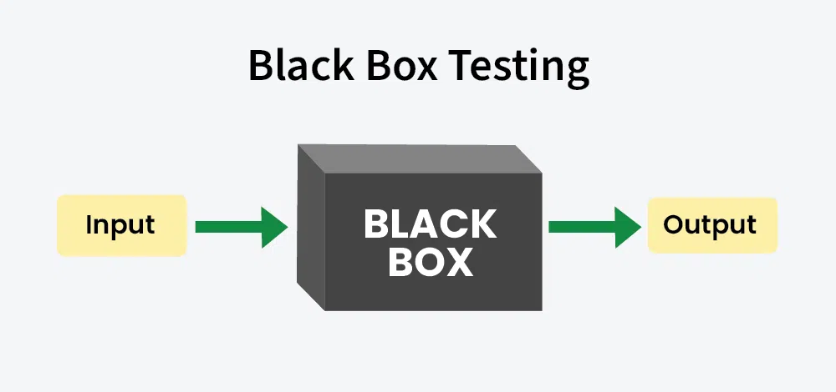
Black Box Testing

Slide 16
White Box Testing
White Box Testing is a method of software testing in which the user knows the internal design/ implementation/ structure of the tested item.
The tester has access to the source code and uses this knowledge to design test cases that can verify the correctness of the software at the code level.
This method requires the tester to have in-depth knowledge of a software’s structure and programming language.

Slide 17
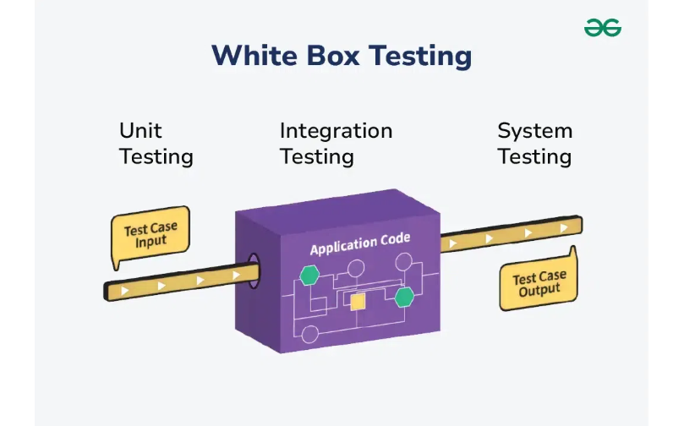
White Box Testing

Slide 18
Level of Testing
Unit Testing :-
Unit testing is a software testing technique which allows developers to test small, individual parts, or units, of an application by themselves.
A unit might be a function, a method, or an object in object-orientated code.
The purpose of unit testing is to ensure that each unit functions as planned before developing larger units around it.

Slide 19
Level of Testing
Integration Testing :-
The goal of Integration Testing is to identify any problems or bugs that arise when different components are combined and interact with each other.
It mainly tests interface between two software units or modules.
It focuses on determining the correctness of the interface.
Once all the modules have been unit-tested, integration testing is performed.
Integration testing can be done by picking module by module.
This can be done so that there is a proper sequence to be followed.
Exposing the defects is the major focus of the integration testing and the time of interaction between the integrated units.

Slide 20
Level of Testing
System Testing :-
The goal of integration testing is to detect any irregularity between the units that are integrated.
System testing detects defects within both the integrated units and the whole system.
The result of system testing is the observed behavior of a component or a system when it is tested.
System Testing is carried out on the whole system in the context of either system requirement specifications or functional requirement specifications or the context of both.
System testing tests the design and behavior of the system and also the expectations of the customer.
It is performed to test the system beyond the bounds mentioned in the software requirements specification (SRS).
System Testing is performed by a testing team that is independent of the development team and helps to test the quality of the system impartial.

